Slide 1
SOFTWARE DEVELOPMENT 3
File I/O in Java(3)

Slide 2
StringTokenizer
StringTokenizer can be used to parse a line into words
This class is part of the java.util package
  you can specify delimiters (the character or characters that separate words)
    the default delimiters are "white space" (space, tab, and newline)

Slide 3
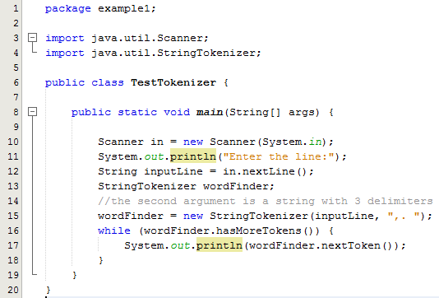
Sample Program 1 – Keyboard Input
Line 13: Declares a reference variable of type StringTokenizer
Line 15: Initialises wordFinder by calling the constructor
Constructor takes two parameters
1st parameter is the string to be tokenized
2nd parameter is the types of delimiters that separate the words
The while loop is used to traverse through the string that the user typed at the keyboard and return the next token
Sample Output:
Enter the line:
This is,the.line
This
is
the
line

Slide 4
Sample Program 2 – File Input
Now lets look at reading in the data from a file where a comma is used to separate the values as follows:
The file employees.txt has the following data
  Donnell,John,34
  Collins,Tony,18
  Greally,Jim,16
  Brady,Noel,69
Note that the data for each employee is now on one line with each bit of data separated by a comma
We now want to open this file, read in the data and print it to the screen

Slide 5
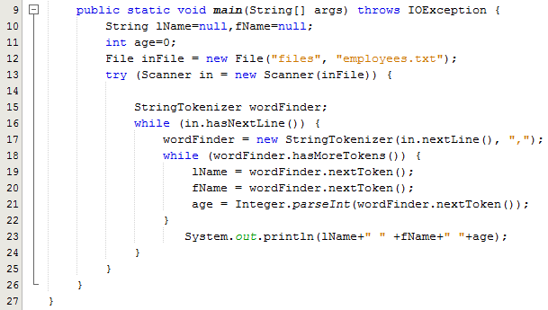
Sample Program 2 – File Input
In this example we have a nested while loop
The outer loop reads each line from the file
The inner while loop is used to traverse through each line and return the 3 tokens in this case – last name, first name and age
These are then printed to the screen
Sample Output:
Donnell John 34
Collins Tony 18
Greally Jim 16
Brady Noel 69

Slide 6
Sample Program 3 – TestEmployee
Now we will revisit the class exercise we did using the Employee.java and TestEmployee.java classes
In this exercise we read from the file employees.txt where the data for each employee were all on separate lines
The file employees.txt has the following data
  Donnell,John,34
  Collins,Tony,18
  Greally,Jim,16
  Brady,Noel,69
We now want to open this file, read in the data, create Employee objects, add them to the array list and print them out

Slide 7
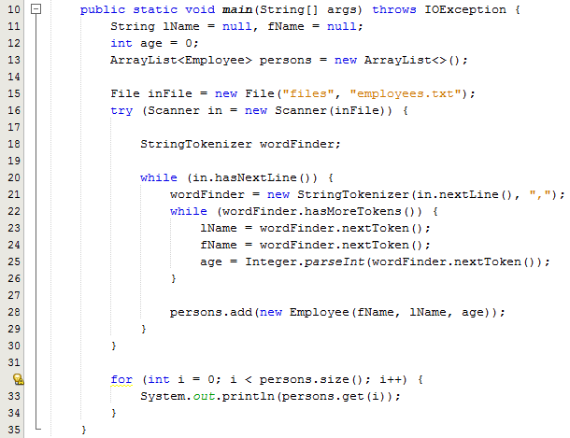
Sample Program 3 – TestEmployee
In this example we have a nested while loop like sample program 2
The outer loop reads each line from the file
The inner while loop is used to traverse through each line and return the 3 tokens in this case – last name, first name and age
These are then passed as parameters into the Employee constructor and the object is added to the arraylist
Line 32-34: Prints out the contents of the arraylist

Slide 8
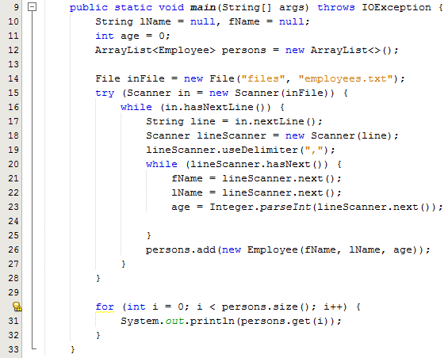
Sample Program 4 – Using Scanner to split a string
Instead of using the StringTokenizer class, we can use the Scanner class to split a string
Line 17: From this line of code we got a line from the file content.
Line 19: Now we want to split the line with a comma as the character
Lines 20-25 uses a while loop to process the line and read each string into a variable

Slide 9
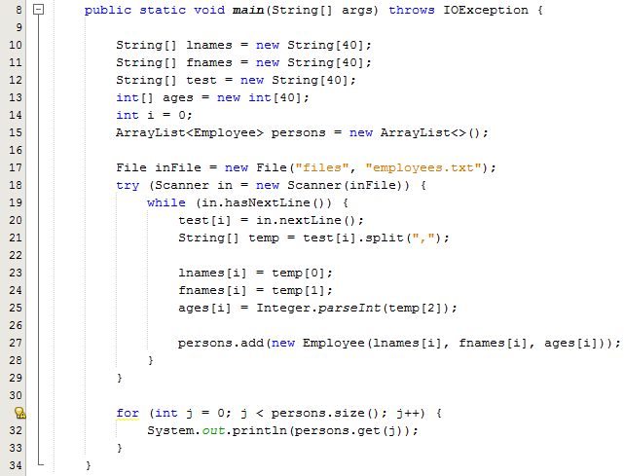
Sample Program 5 – Using split method to split a string
Line 19: Check for a line
Line 20: Read the line into a String array called test
Line 21: Call the split method and assign the results of this method into a new array called temp
Lines 23-25 assigns lname, fname and age into separate arrays

Slide 10
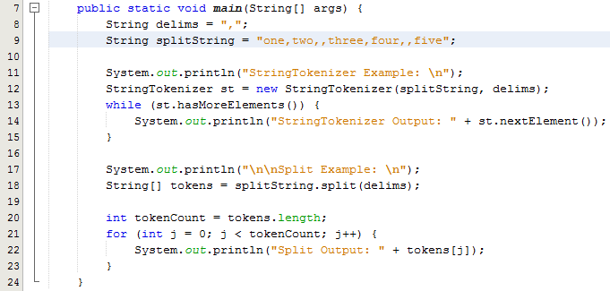
Difference between split() & StringTokenizer
Sample Output
StringTokenizer Example:
StringTokenizer Output: one
StringTokenizer Output: two
StringTokenizer Output: three
StringTokenizer Output: four
StringTokenizer Output: five
Split Example:
Split Output: one
Split Output: two
Split Output:
Split Output: three
Split Output: four
Split Output:
Split Output: five
Line 9: The string uses the comma as a delimiter but note the two occurences of the commas in the string on line 9
The Stringtokenizer ignores the 2nd comma but the spit method treats it as a new blank token
Note the difference in the sample output

Slide 11
Interesting Example
We have file one called worldpop.txt which contains the name of the country and the population all on the same line as shown below:
  Afghanistan 32738376
  Akrotiri 15700
  Albania 3619778
  Algeria 33769669
  American Samoa 57496
We have a 2nd file called worldarea.txt which contains the name of the country and the area all on the same line as shown below:
  Afghanistan 647500
  Akrotiri 123
  Albania 28748
  Algeria 2381740
  American Samoa 199

Slide 12
Interesting Example
We now wish to read both of these files and calculate the density of each country and write it to a file called worlddensity.txt
We note in the two input files that spaces are used to separate the country from the numeric values
Spaces are also used to separate countries with multi word names
  American Samoa 57496
How do we process this file to separate the country (String) from the population or area which are both numbers

Slide 13
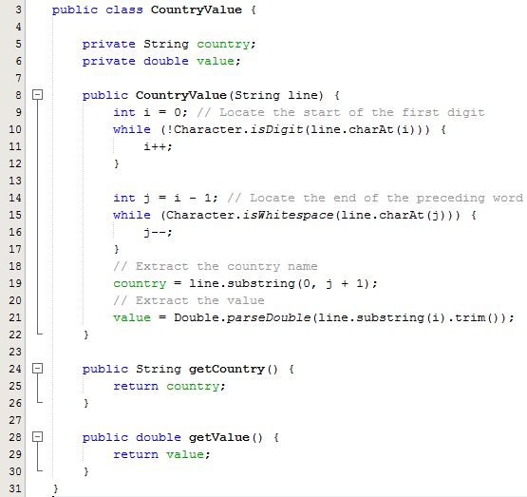
Interesting Example -Solution
CountryValue class is used to represent the contents of both files i.e. country and value
The constructor takes a string as a parameter and extracts from this string the country and the numeric value e.g.
American Samoa 57496
After the while loop is executed the value of i is 16
Line 14: j is then given the value 15
While the string has spaces we keep decrementing j

Slide 14
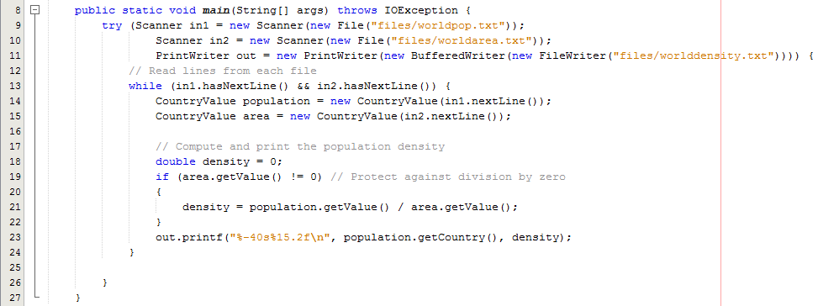
Interesting Example -Solution
Lines 9,10,11: All three files are opened
Line 13: The while loop reads from both input files and calls the constructor from the CountryValue class
Lines 18-23: calculates the density and writes it to the output file
Line 23: Note the formatting %-40s means 40 characters and left justified %15.2f means 15 characters formatted to 2 decimal places and right justified

